Slide 1
Week-6
Big Data Analytics with Spark
In this module, you will use the data from a webserver to analyse search terms. You will then load a pretrained sales forecasting model and predict the sales forecast for a future year.
Learning Objectives
Analyze search terms data from an e-commerce web server.
Deploy a sales forecast Machine Learning (ML) model.
Predict the sales for a future year by executing the ML model on an Apache Spark cluster.

Slide 2
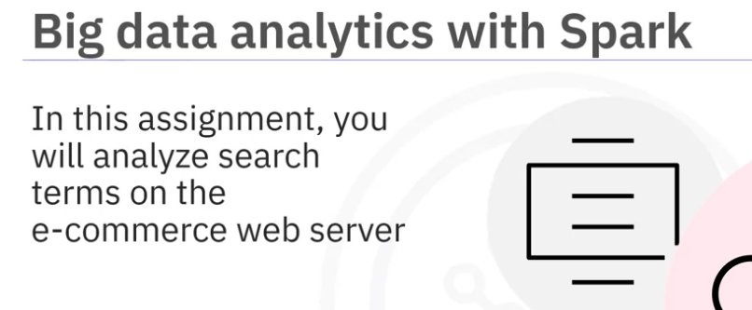
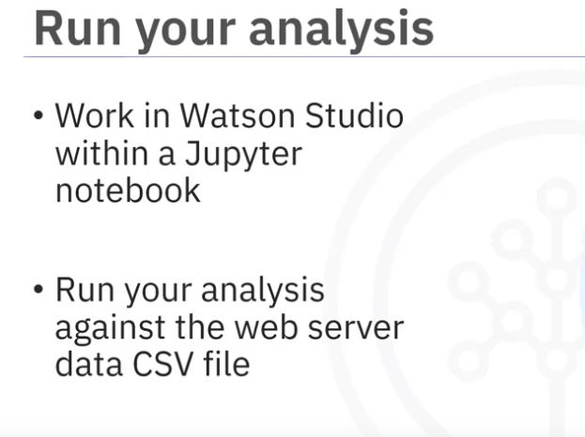
you will perform a number of tasks to analyze search terms on the e-commerce web server.
You will work in Watson Studio within a Jupyter notebook to run your analysis against a CSV file containing the webserver data.

Slide 3
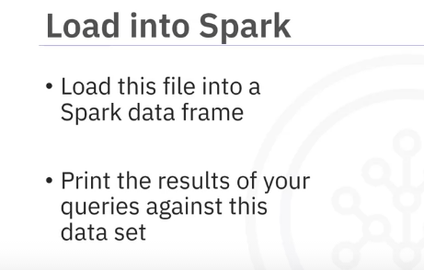
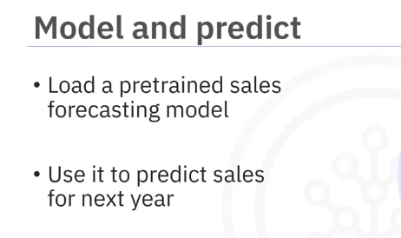
You will load this file into a Spark data frame and print the results of your queries against this data set.
You will then load a pretrained sales forecasting model and use this to predict the sales for next year.

